Slide 1
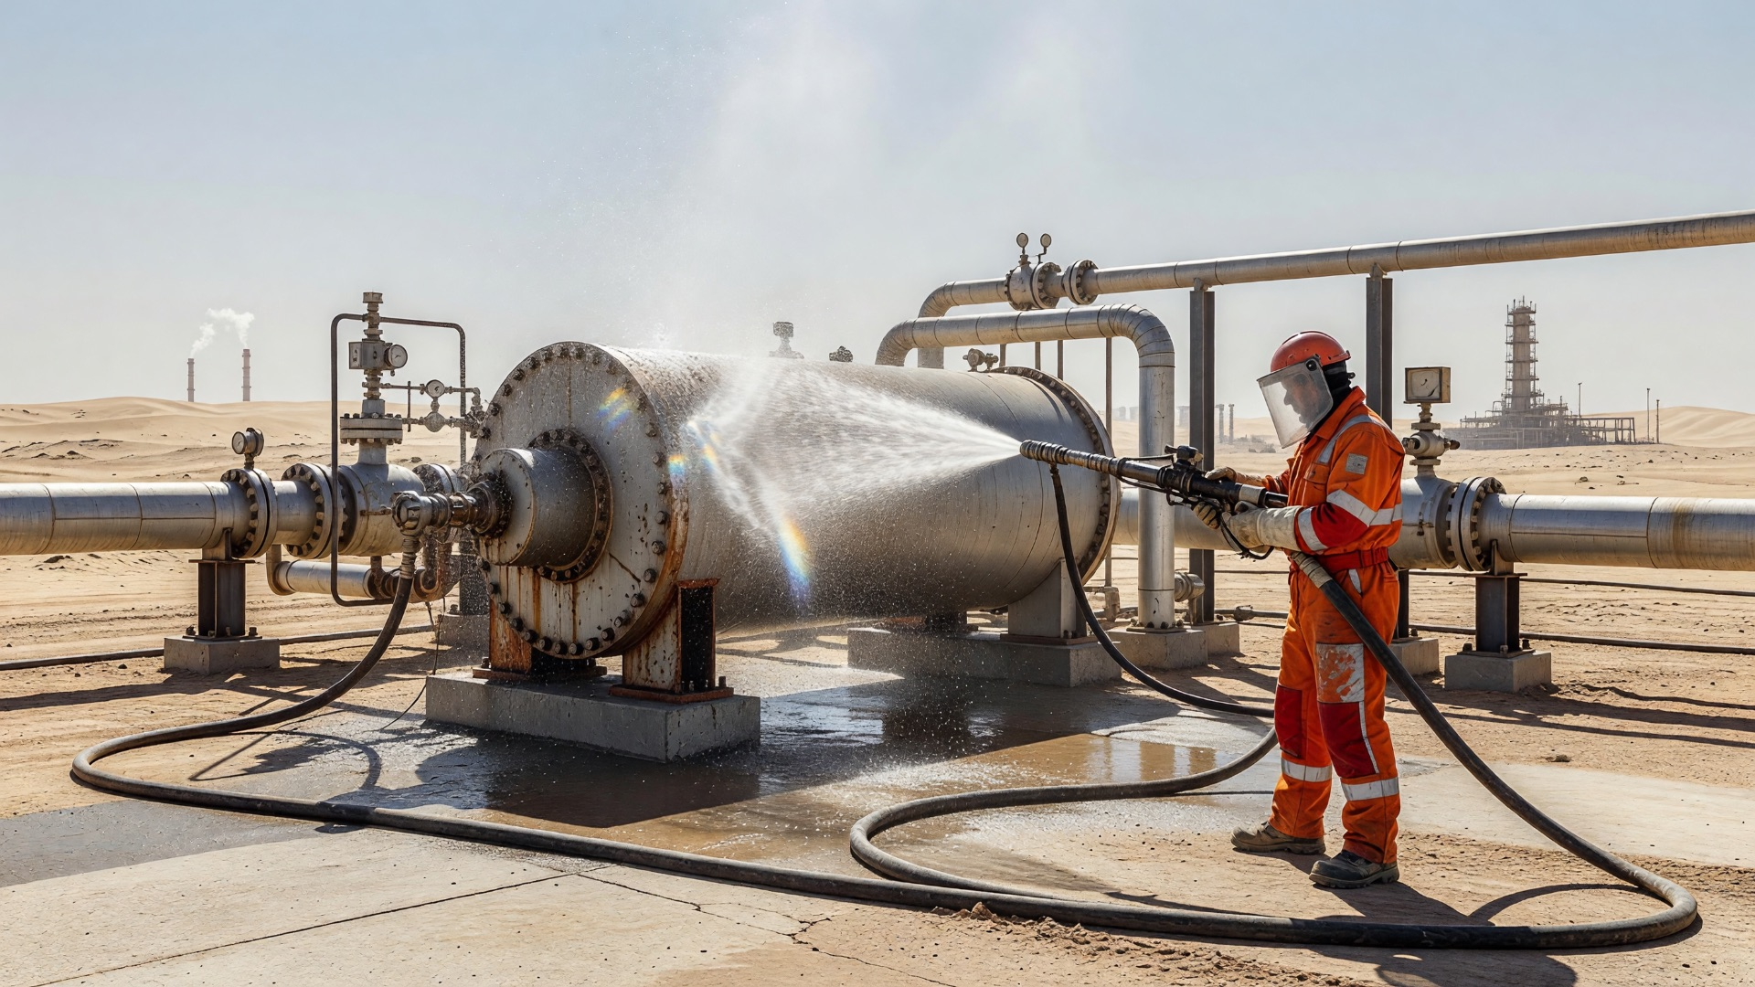
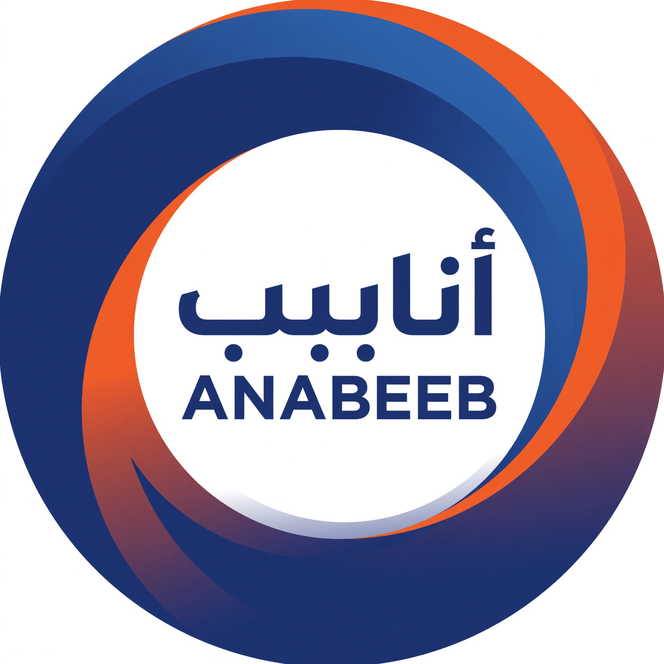
High Pressure Water Jetting
Basic Operator Training
(Awareness & Field Verification)
Day 1 – Safety Foundation, Hazards, Medical Response & Controls
Anabeeb HSE & Training | NEBOSH Verified Programme
END-TO-END SOLUTIONS

Slide 2
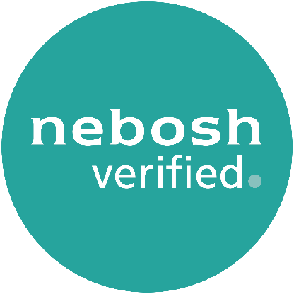
NEBOSH Verified Program
NEBOSH, formed in 1979, is a globally recognized awarding organization.
It provides high-quality health, safety, and environmental qualifications.
Anabeeb partners with NEBOSH to ensure high-quality Work Permit Receiver Training.
The NEBOSH Verified logo signifies training quality.
Successful completion earns an e-certificate.
This training enhances safety in oil and gas plants.

Slide 3
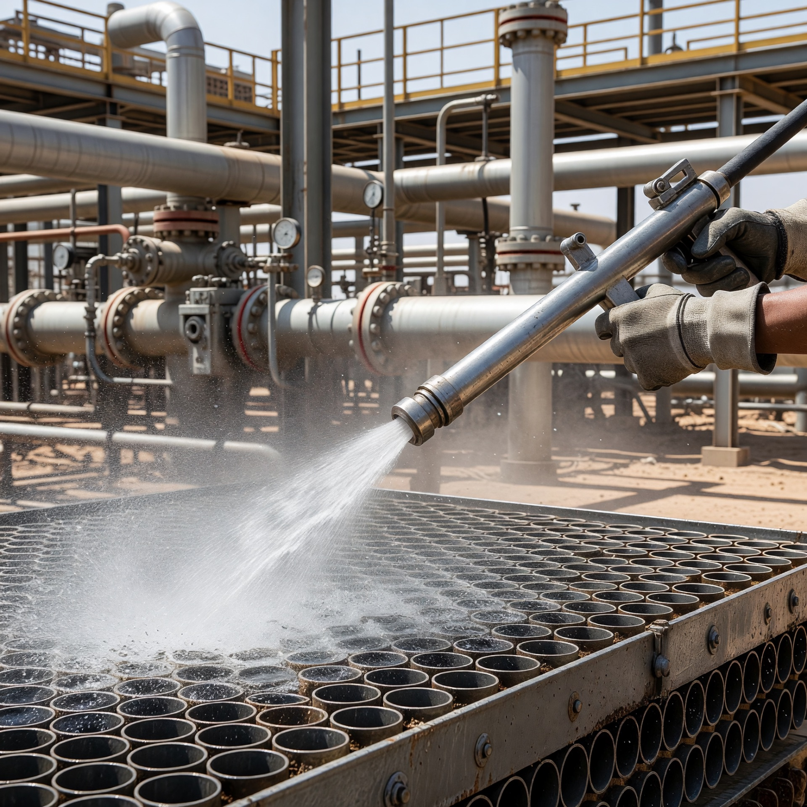
What is High Pressure Water Jetting?
WHAT IS HIGH PRESSURE WATER JETTING?
• High pressure water jetting uses a pump to move large volumes of water through a small nozzle.
• The nozzle creates the cutting or cleaning force.
• Pressures commonly reach 10,000 to 20,000 psi on Anabeeb work.
• It is used for surface cleaning, tube cleaning, pipe cleaning and more during shutdowns and maintenance.
Key Principle
The pump moves the water. The nozzle turns that flow into extreme force. This is a controlled cutting tool – not just cleaning equipment.

Slide 4
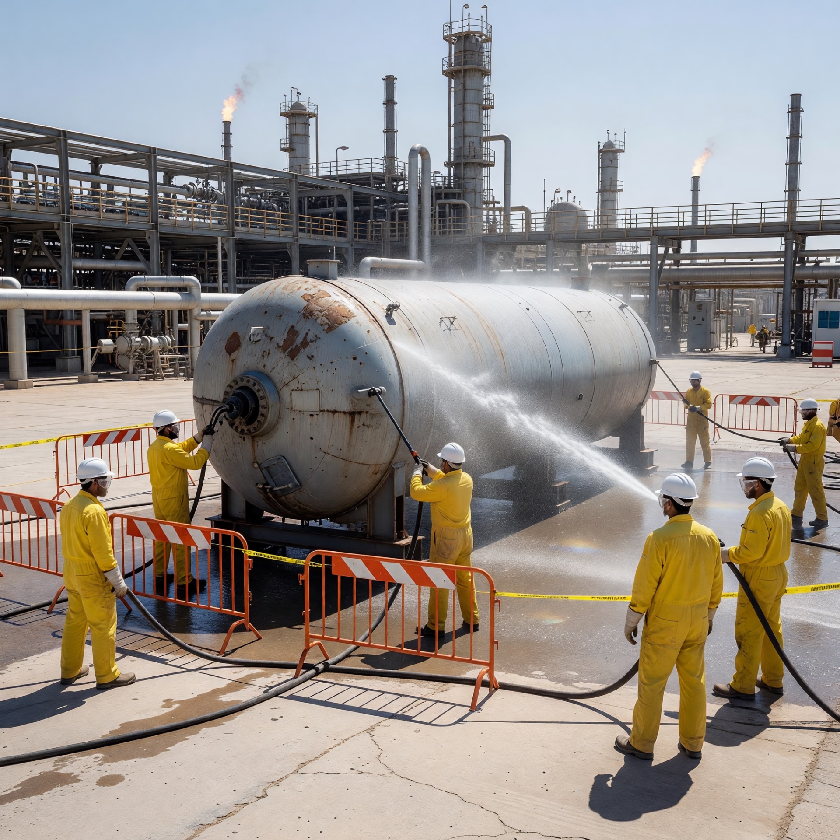
Where HPWJ is Used on Our Sites
WHERE HPWJ IS USED ON OUR SITES
Common applications on Anabeeb and client sites:
• Heat exchanger and bundle cleaning
• Pipe and line cleaning
• Surface preparation before coating
• Vessel and tank cleaning
This work is always part of shutdown and turnaround activities. Strict controls are required every time.

Slide 5
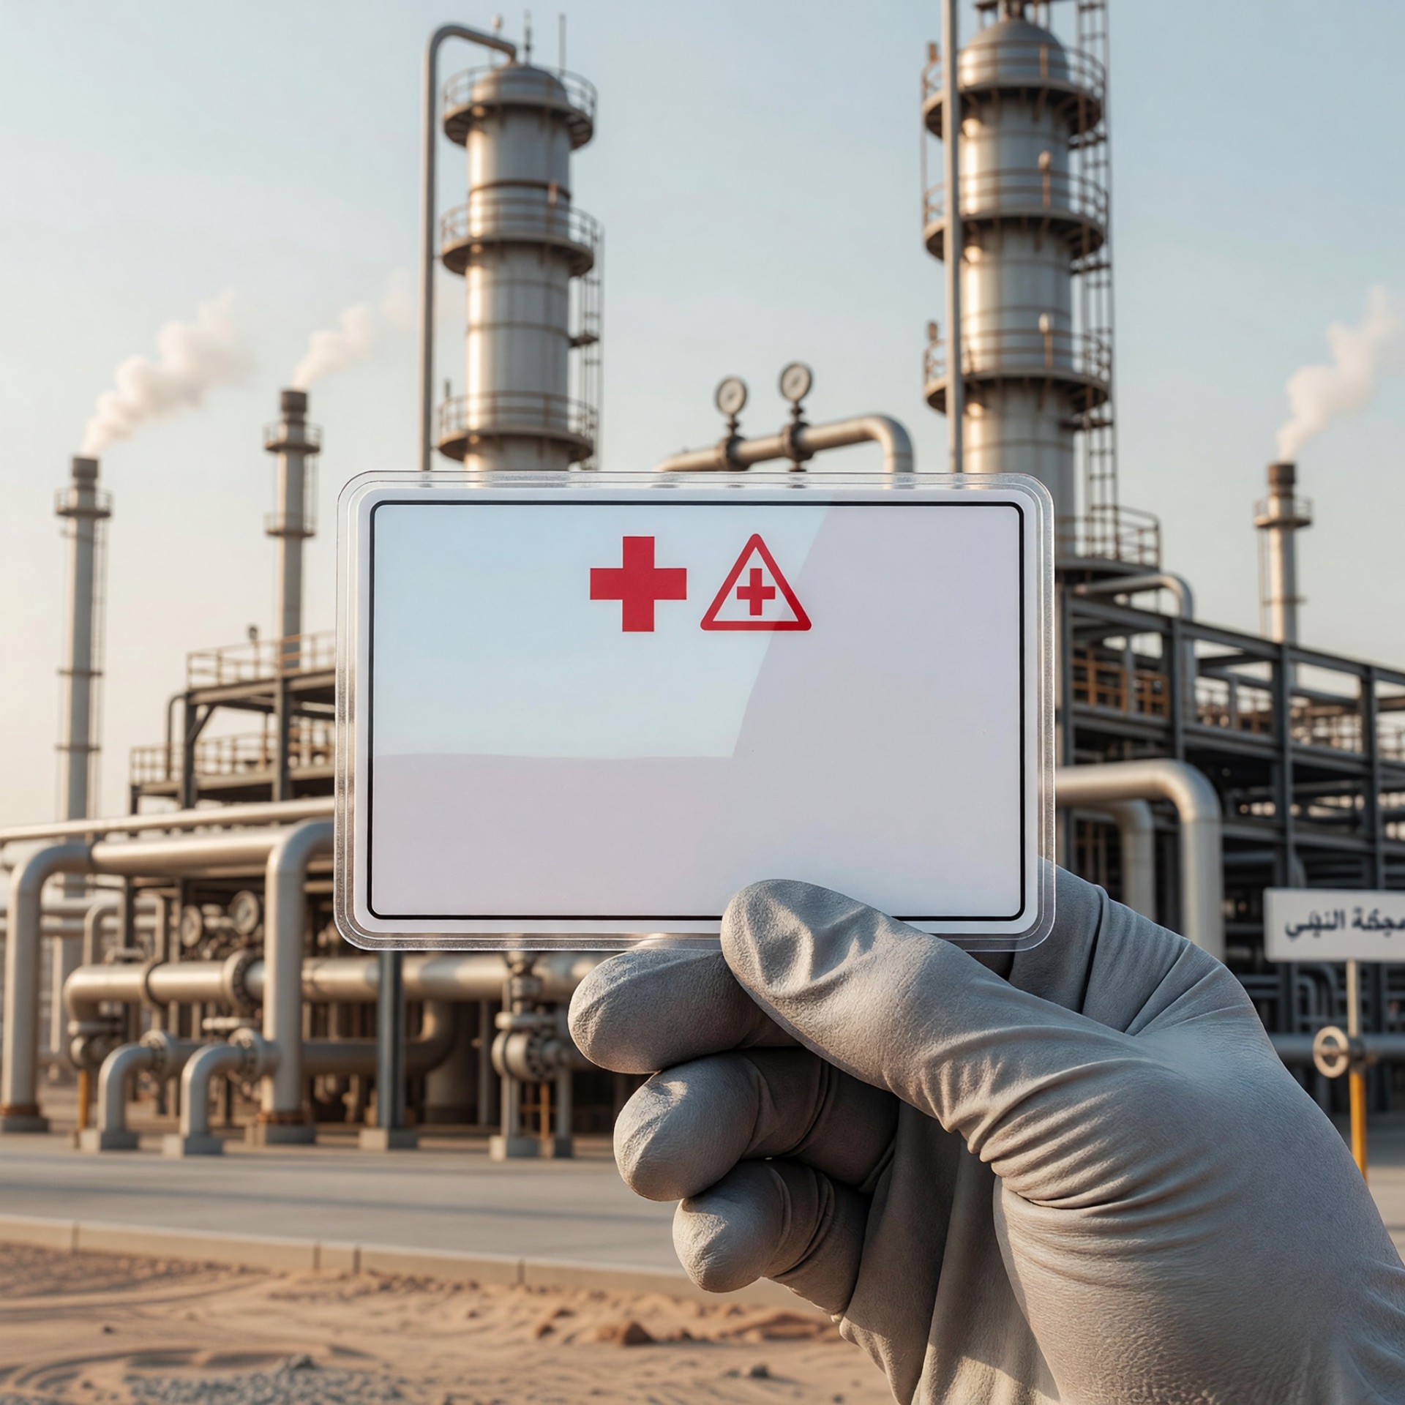
Why Waterjet Injuries Are Different
WHY WATERJET INJURIES ARE DIFFERENT
• Waterjet injuries are different from normal cuts or bruises.
• Even a small external wound can hide severe internal damage.
• Medical attention is required for ALL suspected waterjet injuries – no exceptions.
• The Medical Alert Card tells medical staff exactly what to look for and what treatment is needed.
• It can save your life.

Slide 6
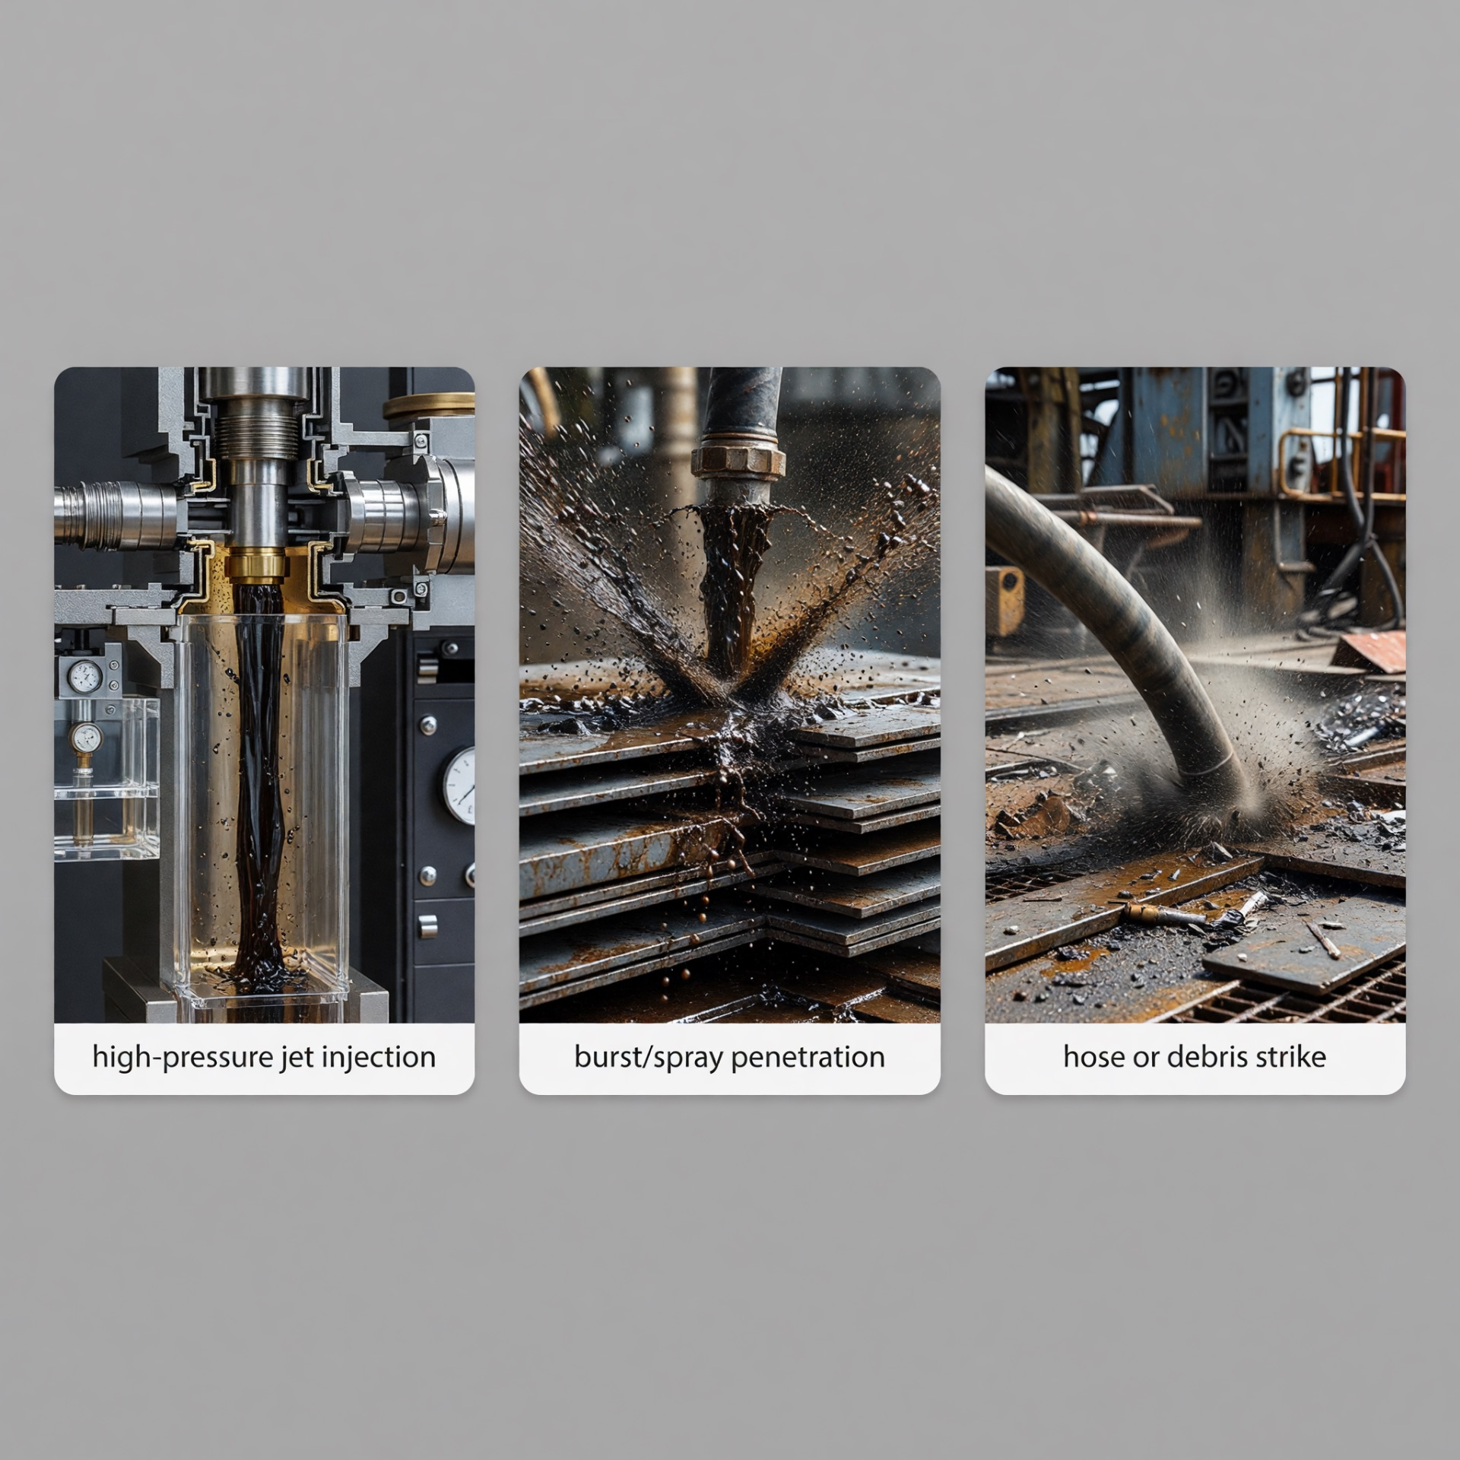
Types of Waterjet Injury
TYPES OF WATERJET INJURY
1. Water-Cut – direct injection of water into the body
2. Water-Burst – sudden high-velocity burst penetrating tissue
3. Struck-By – hose, tool or debris hitting the body
All three must be treated seriously. The Medical Alert Card covers all types. Never assume an injury is minor.

Slide 7
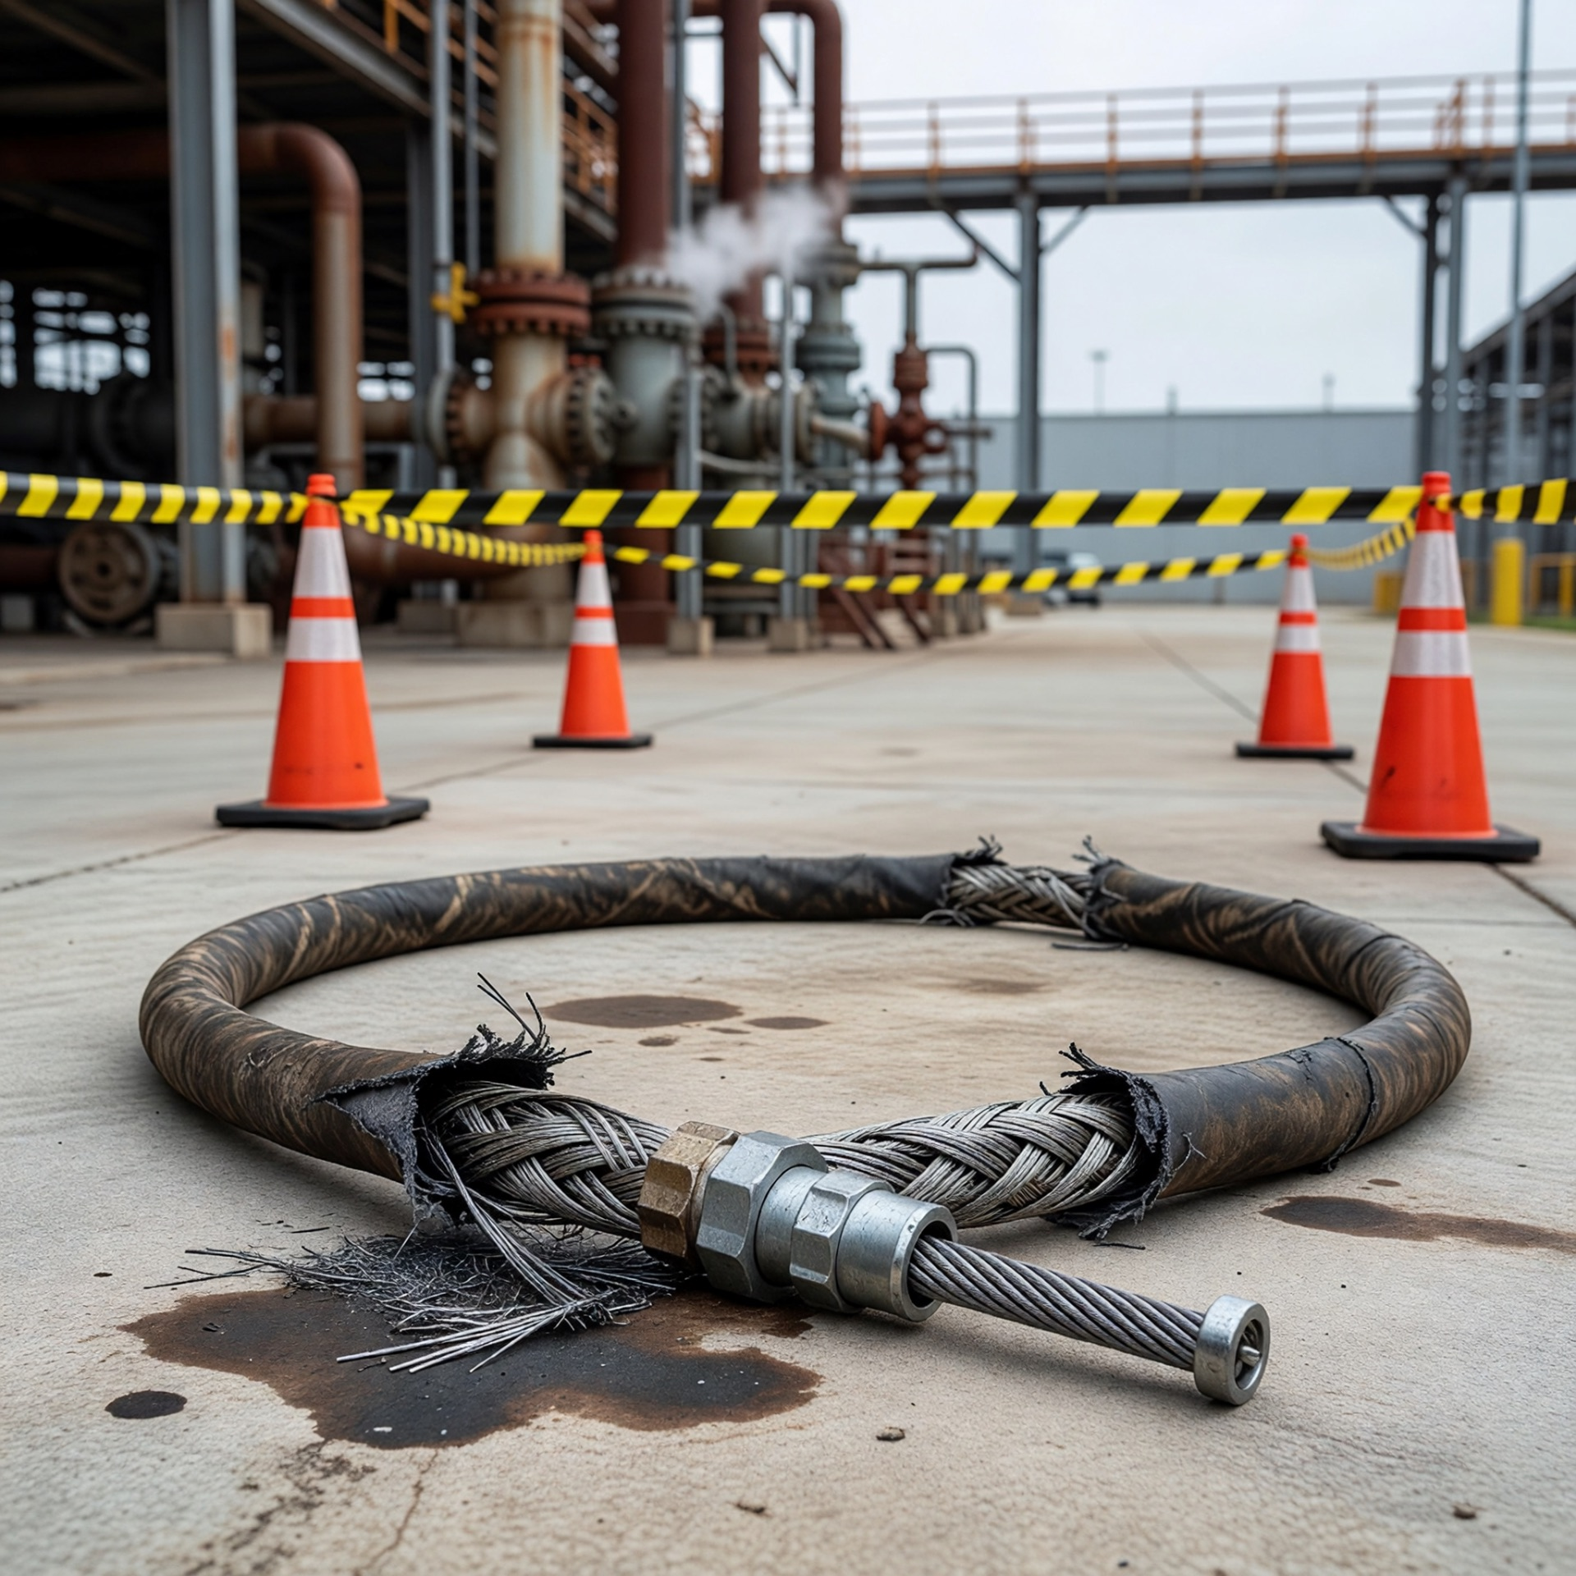
Real Incident Examples – Never Again
REAL INCIDENT EXAMPLES – NEVER AGAIN
Real incidents have happened in the industry:
• Hose failure causing struck-by injury
• Jet cutting through PPE and causing internal damage
• Delayed medical treatment because the injury looked minor
Lesson: Proper controls, pre-use inspection and immediate medical response save lives. We study these incidents so we never repeat them.

Slide 8
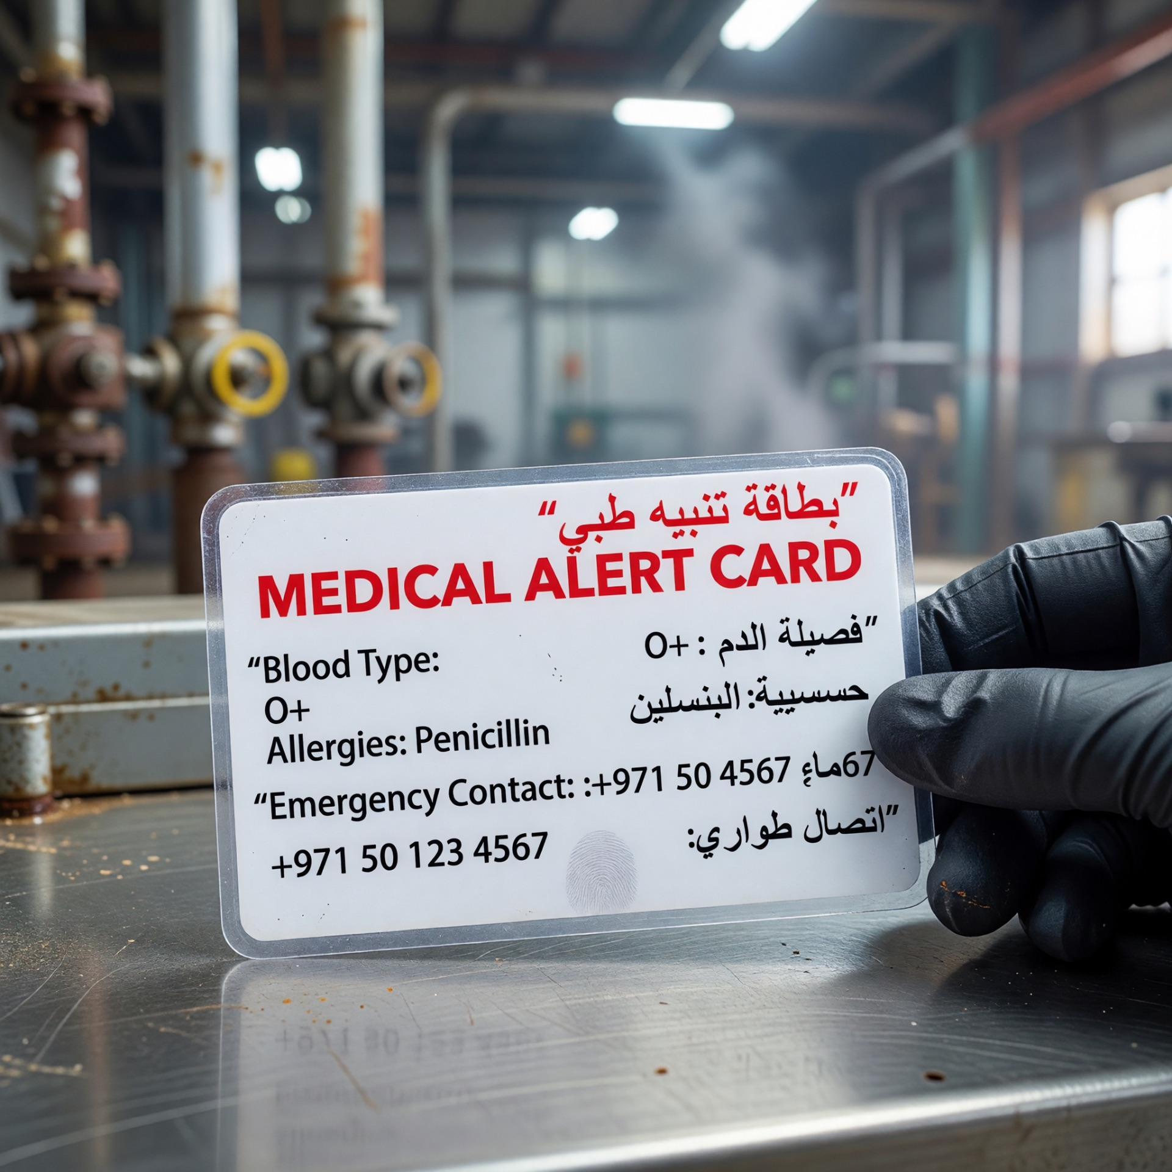
The Medical Alert Card – Your Lifeline
THE MEDICAL ALERT CARD – YOUR LIFELINE
• Issued today – you must carry it on every high pressure water jetting job.
• Waterproof and easy to access.
• Tells medical staff exactly what treatment is needed.
• External appearance cannot predict internal damage.
• This is a mandatory safety requirement – not optional.
From this moment you are never allowed on a HPWJ job without this card in your possession.

Slide 9
NEBOSH Verified Programme
NEBOSH VERIFIED PROGRAMME
NEBOSH, formed in 1979, is a globally recognised awarding organisation.
It provides high-quality health, safety and environmental qualifications.
Anabeeb partners with NEBOSH to ensure high-quality High Pressure Water Jetting training.
The NEBOSH Verified logo signifies training quality that meets recognised standards.
Successful completion of the full 3-day programme and assessments earns an Anabeeb certificate and a personal Medical Alert Card.
This training enhances safety during shutdown and turnaround operations on oil and gas sites.

Slide 10
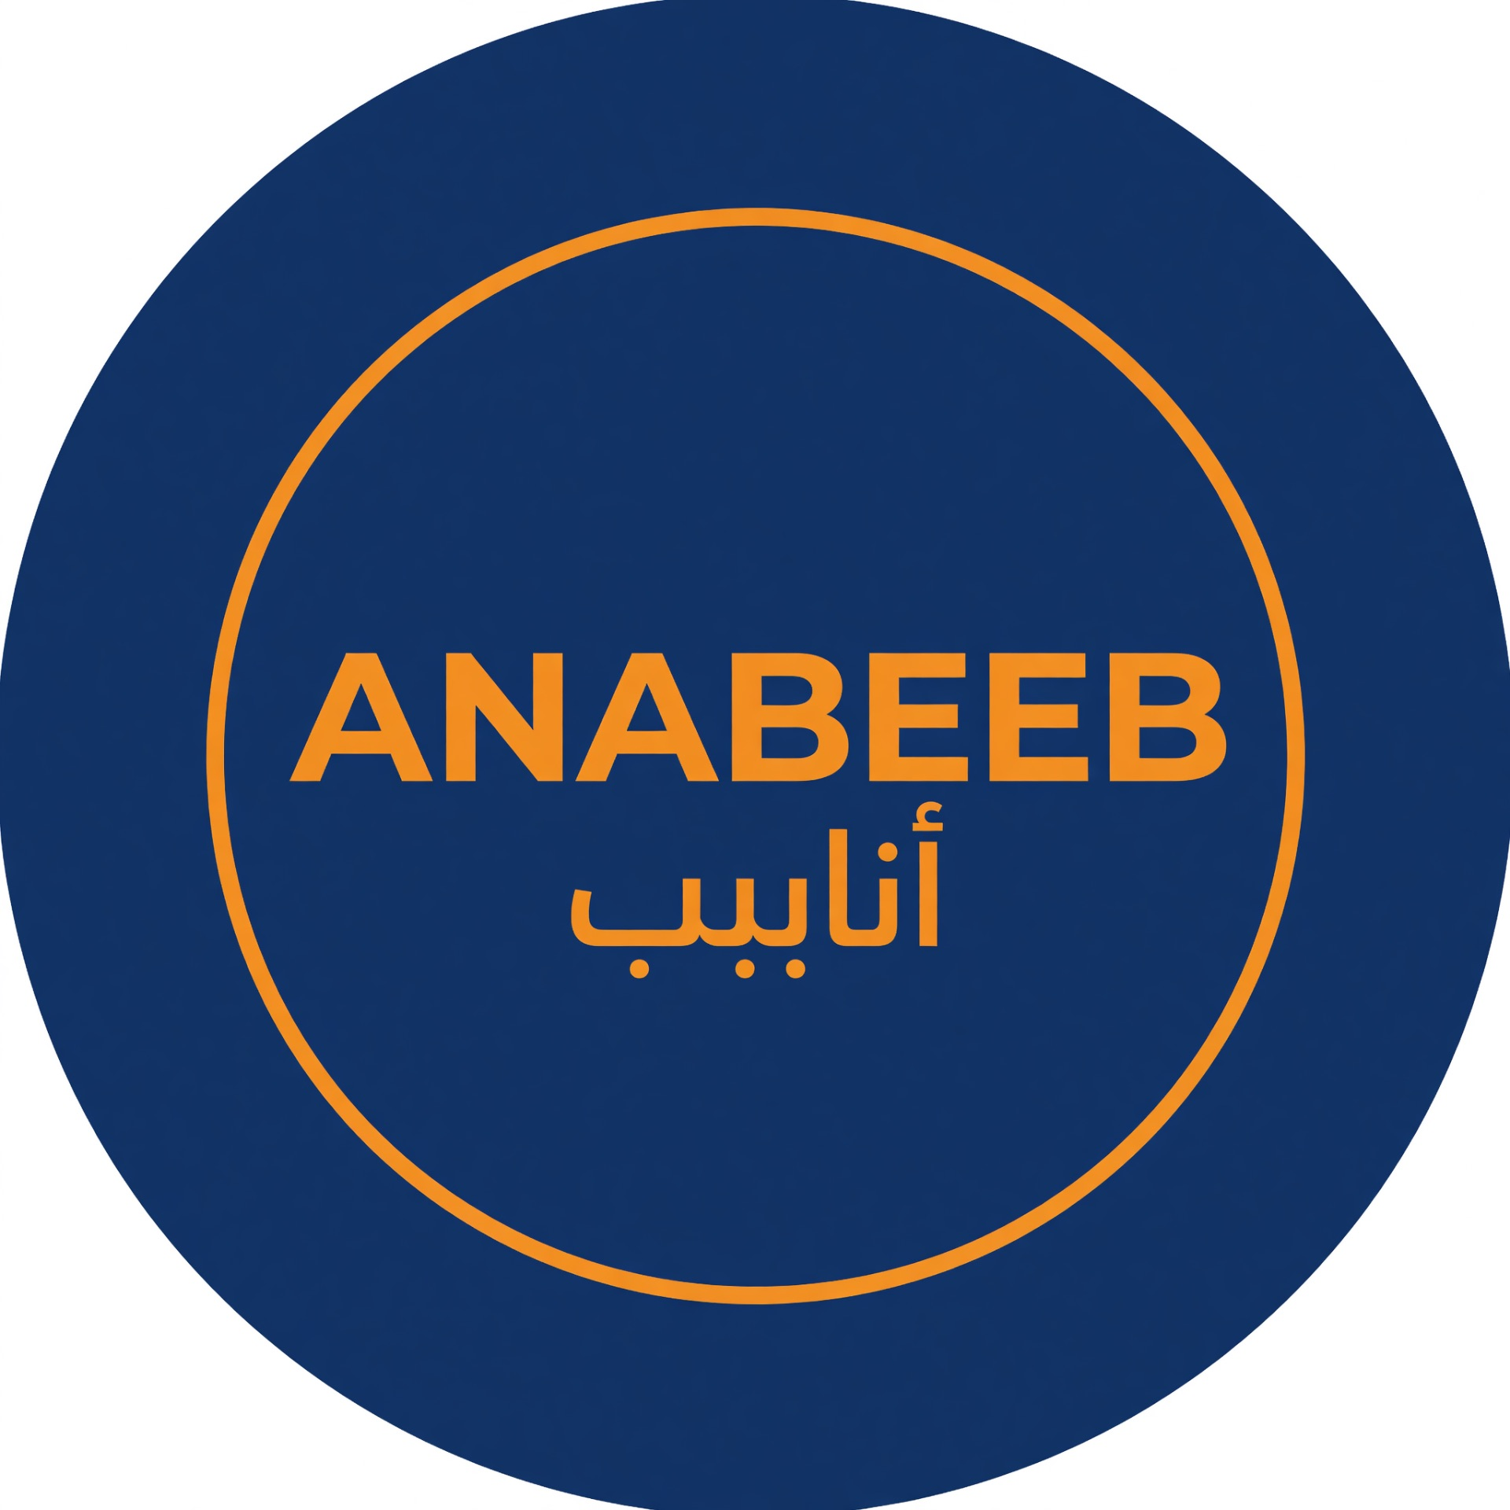
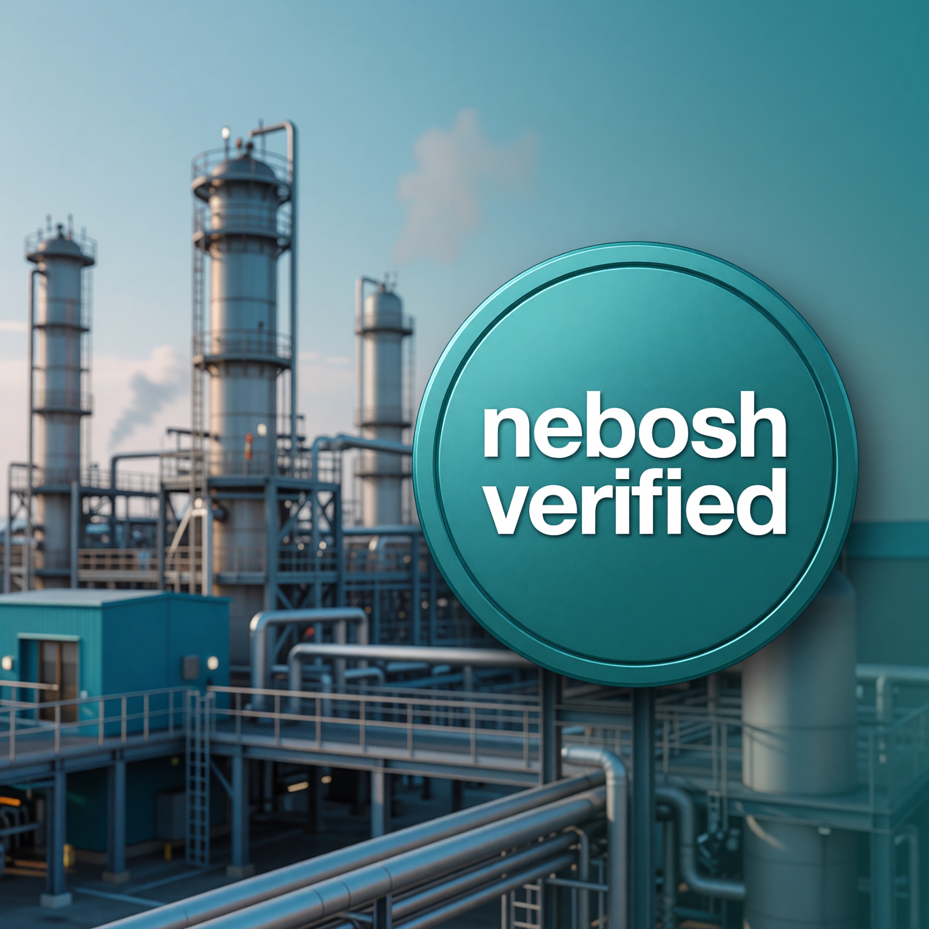
NEBOSH Verified Programme
NEBOSH VERIFIED PROGRAMME
• NEBOSH, formed in 1979, is a globally recognised awarding organisation.
• It provides high-quality health, safety and environmental qualifications.
• Anabeeb partners with NEBOSH to ensure high-quality High Pressure Water Jetting training.
• The NEBOSH Verified logo signifies training quality that meets recognised standards.
• Successful completion of the full 3-day programme and assessments earns an Anabeeb certificate and a personal Medical Alert Card.
• This training enhances safety during shutdown and turnaround operations on oil and gas sites.
1
END-TO-END SOLUTIONS

Slide 11
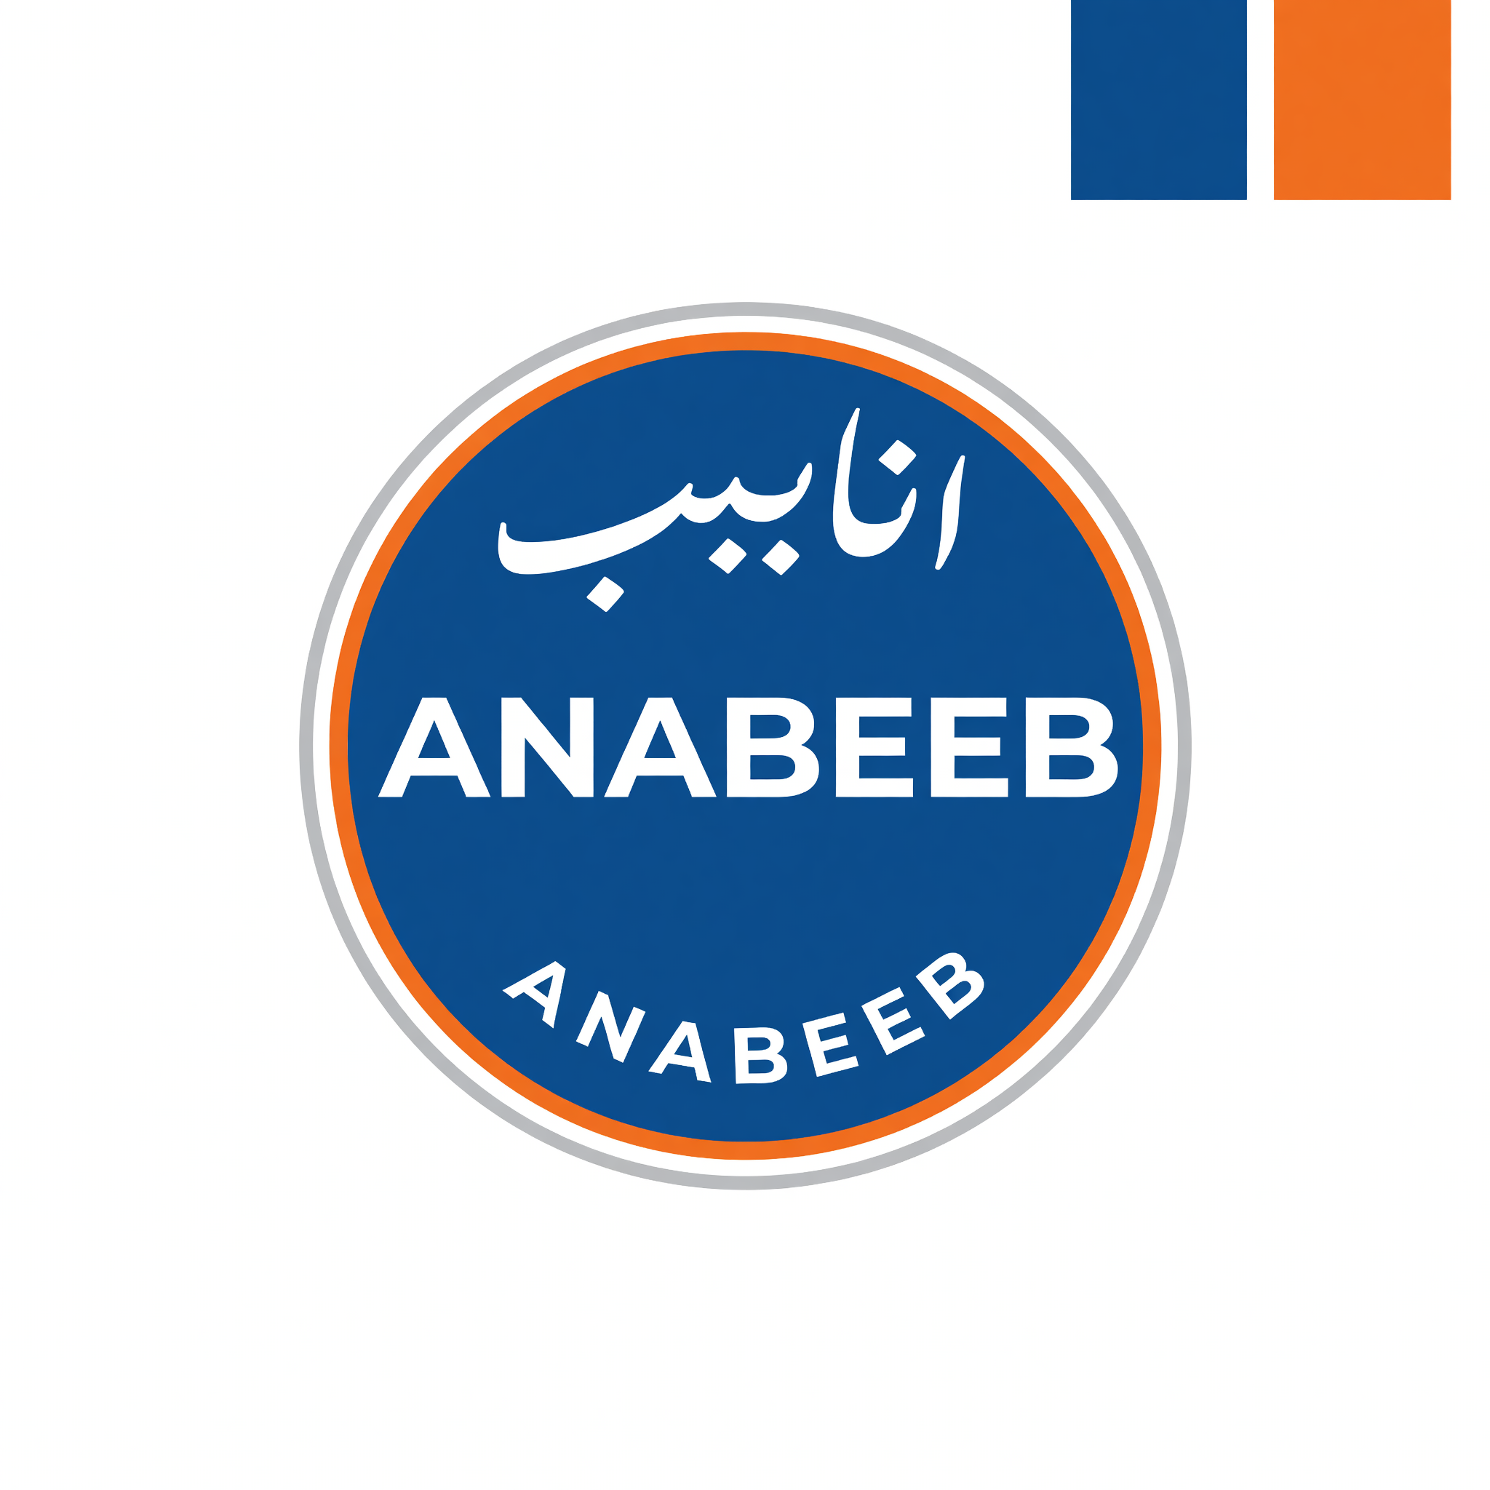
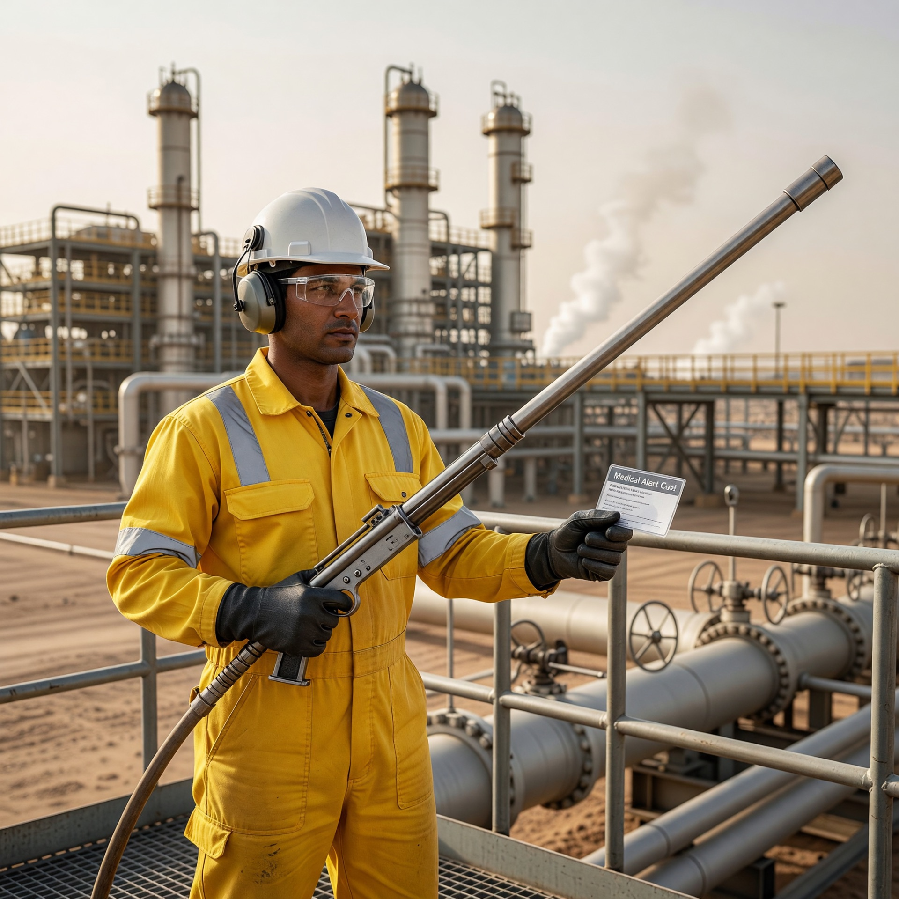
Day 1 Learning Outcomes
LEARNING OUTCOMES
By the end of today you will be able to:
1. Understand why high pressure water jetting injuries are different and serious
2. Explain the Medical Alert Card and when to use it
3. Apply the hierarchy of controls and key site safety rules
4. Understand how the system creates pressure and why control of relief is critical
5. Recognise Stop Work Authority and when to use it
2
END-TO-END SOLUTIONS

Slide 12
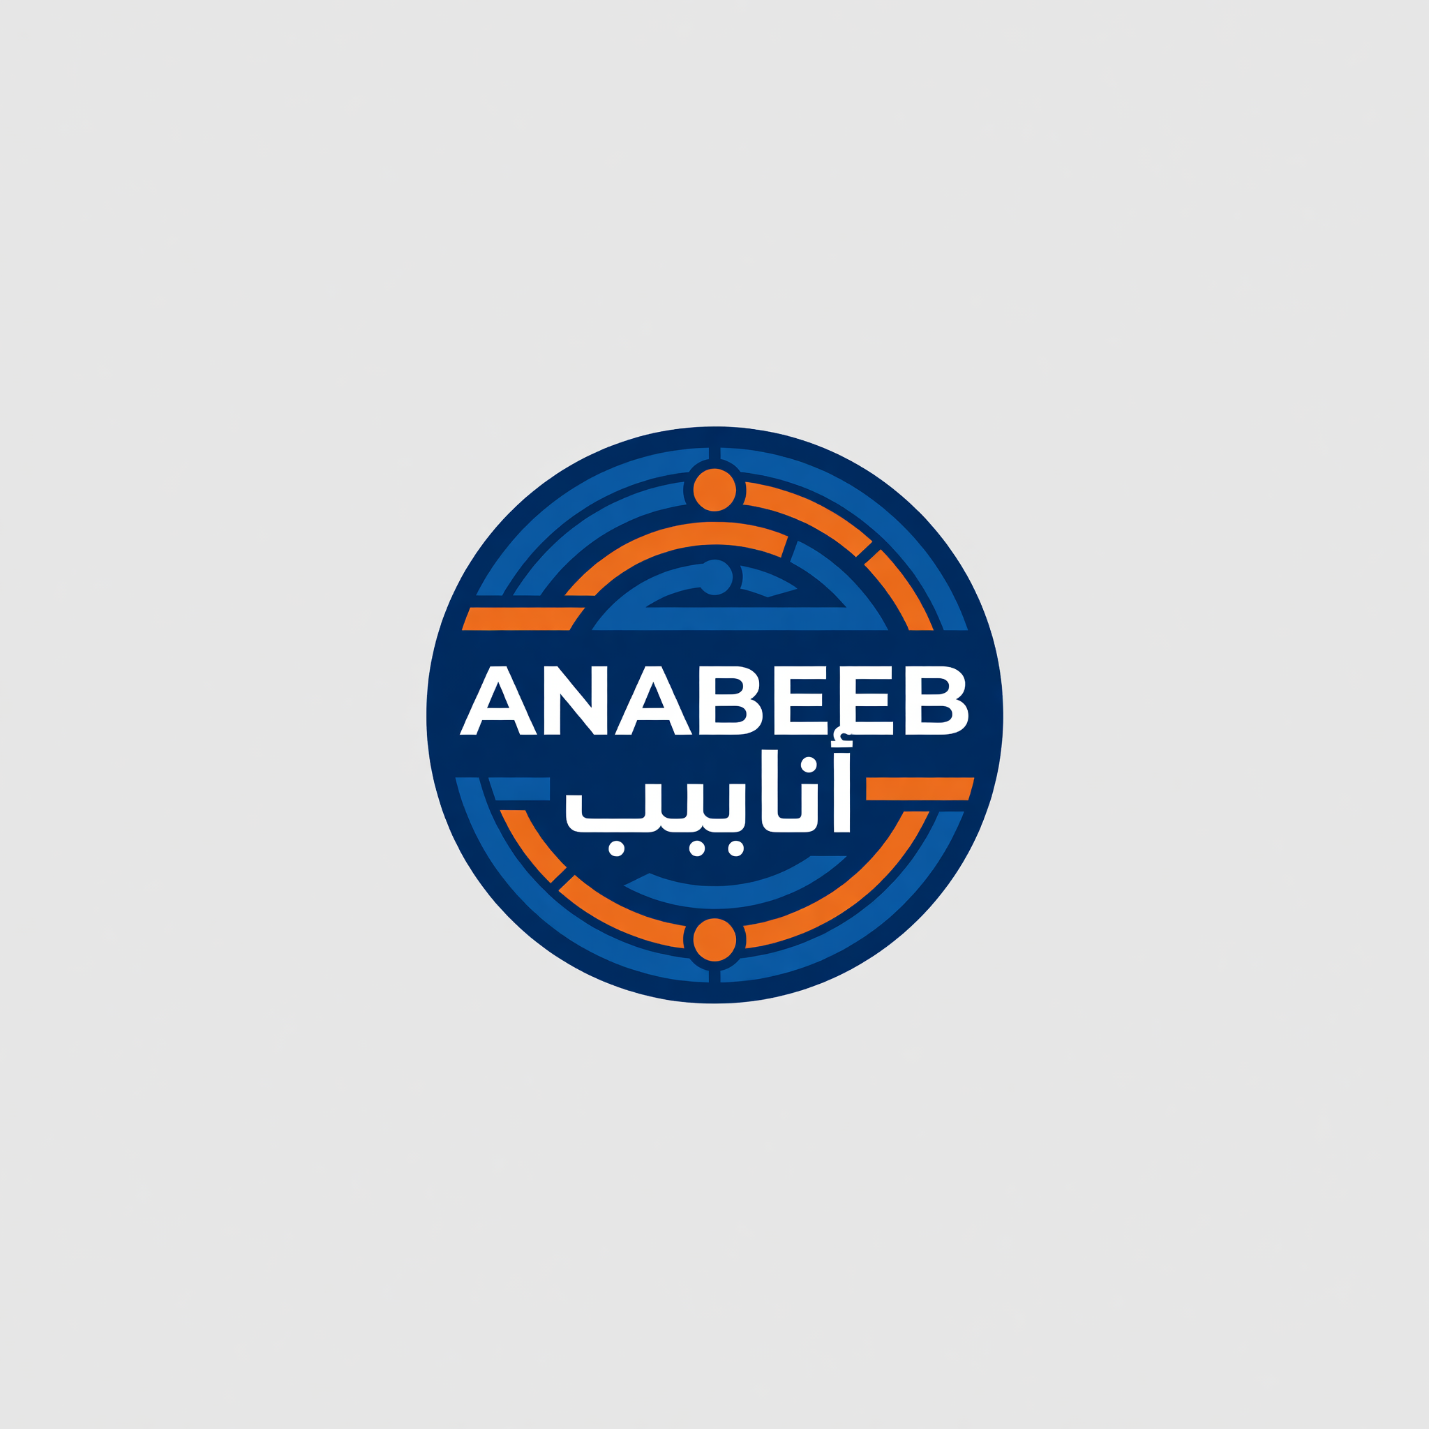
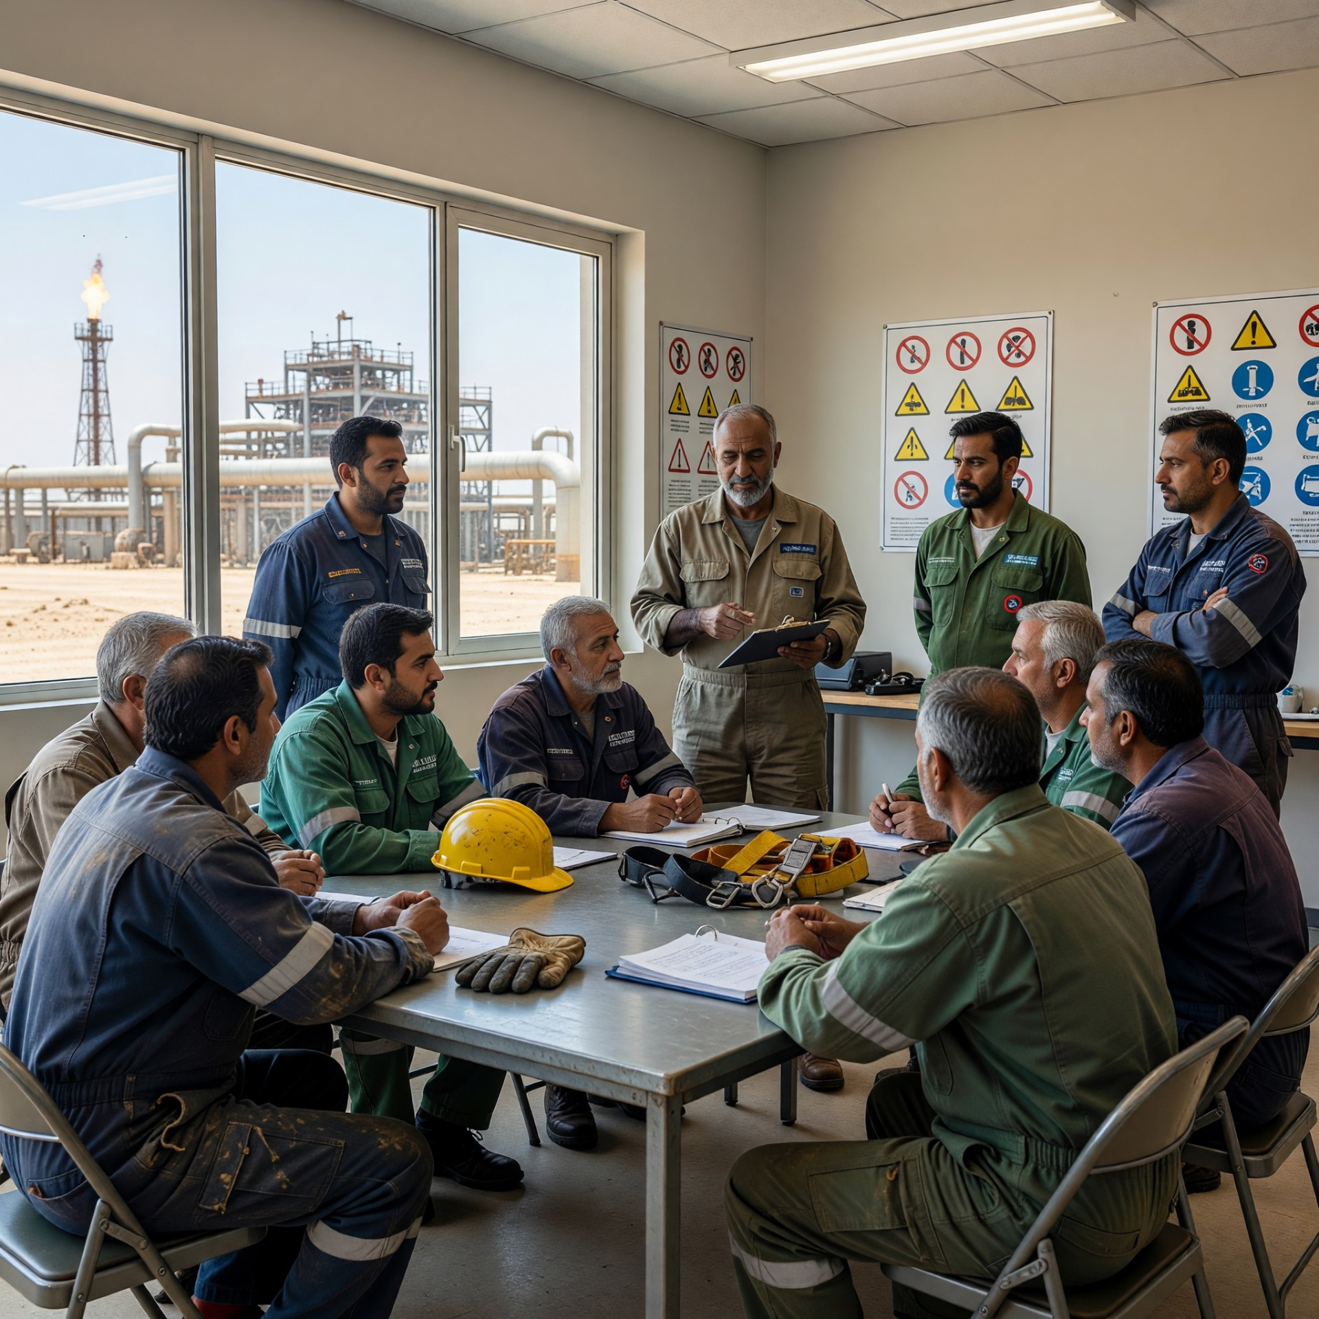
Trainer Introduction & House Rules
TRAINER INTRODUCTION & HOUSE RULES
• This session is interactive, not just a lecture
• You are welcome to ask questions at any time
• Please share your site experiences during discussions
• Respect others when they are speaking
• Mobile phones on silent during the session
4
END-TO-END SOLUTIONS

Slide 13
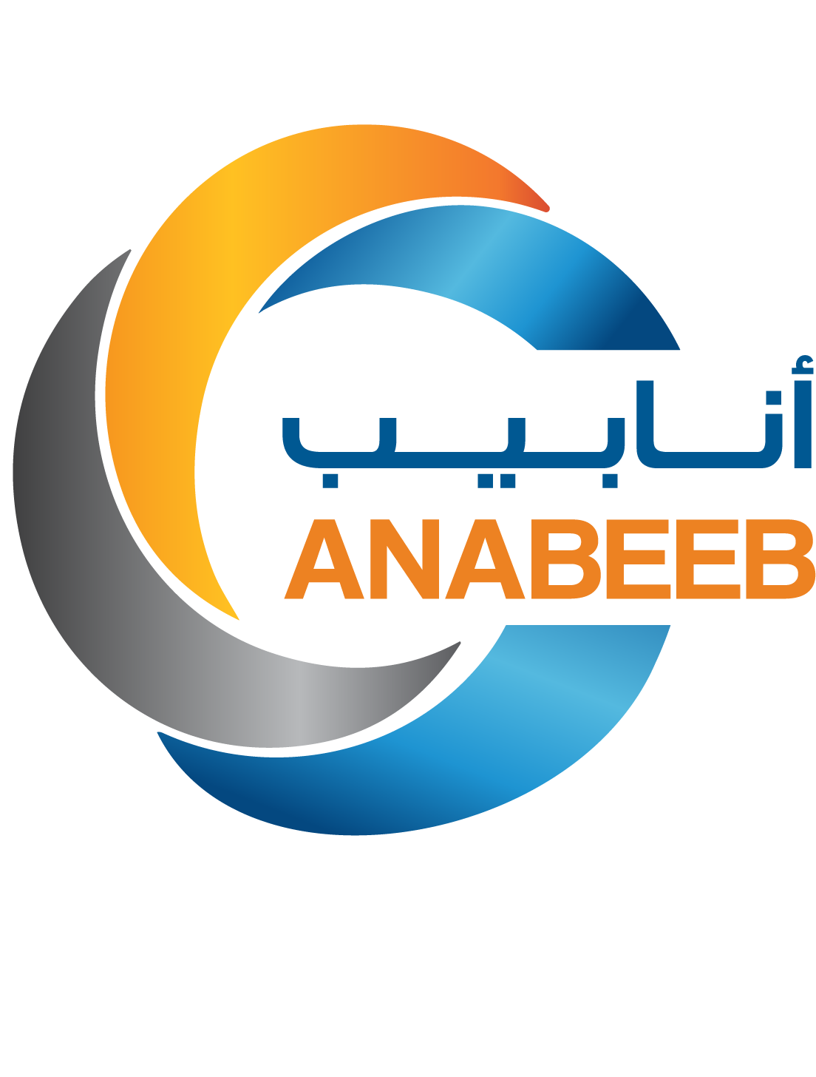
Arabian Pipeline & Services Co. Ltd. (ANABEEB)
P.O. Box 234 Al Jubail | Tel: +966 13 362 0556 | Fax: +966 13 361 4990 | Email: info@anabeeb.com | Website: www.anabeeb.com

